Slide 1
Cultural Humility and Crisis Intervention
James Fitzgerald, Certified CIT Coordinator Deerfield Police Department
Kaitlyn Richotte, LMHC Clinical Support Options

Slide 2
Learning Objectives
At the end of this presentation, participants will be able to:
Define Cultural Humility
Relate Cultural Humility to Crisis Intervention
Implement Cultural Humility into everyday work

Slide 3
Merriam Webster defines culture as “the integrated pattern of human knowledge, belief, and behavior that depends on man’s capacity for learning and transmitting knowledge to succeeding generations.”
It can also be defined as “the customary beliefs, social norms, and material traits of a racial, religious, or social group that have a set of shared values, attitudes, values, and practices.”
Notes:
State that for our purposes, we use second definition…Question: What are some elements of culture? Wait for responses before advancing slide.

Slide 4
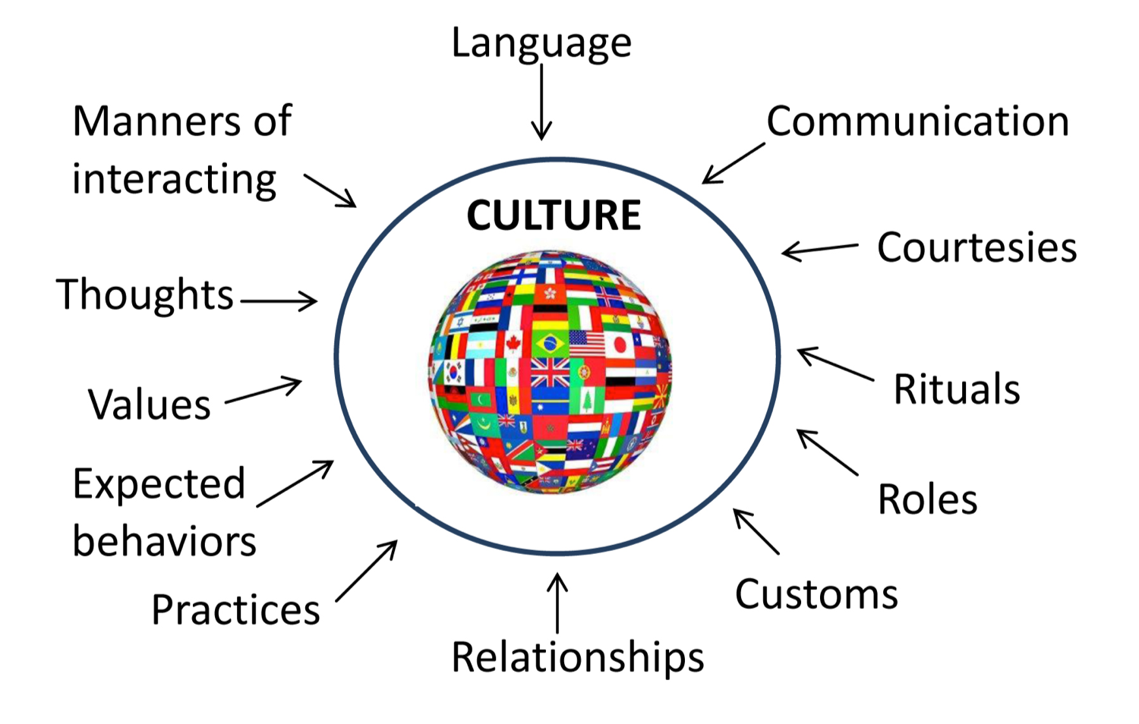
Notes:
Question: What are other aspects are parts of a specific culture? Wait for responses before advancing slide. What other types of culture are there. Wait for responses. (PLEASE someone say, “police culture.” Have fun with this one. Tell stories.

Slide 5
Aspects that affect culture
Gender Roles
Socio-economic Status
Values
Religion
Heritage
Gestures
Biases
Attitude towards weather

Slide 6
Relating Cultural Humility To Crisis Intervention
Notes:
Question: What is “Cultural Humility?” Wait for responses before advancing slide

Slide 8
The relationship of cultural humility and crisis intervention begins with understanding and accepting another culture’s beliefs and practices form that culture’s perspective, and not assessing the worthiness of that culture.
Notes:
That comes through cultural awareness. Discuss cultural awareness and how cultural humility is an expansion of that. Question: What is Cultural Humility. Wait for responses before advancing slide.

Slide 9
Cultural Humility Involves
The ongoing process of self exploration and self critique.
A willingness to learn from others and honoring their beliefs and values.
Recognizing the power imbalance that exists between Law Enforcement and the community.
Notes:
Discuss the importance of officer safety regarding embracing other cultures. Tell story about how men in male dominated cultures might attempt to exit their vehicles during routine traffic stops, or how women in male dominated cultures would rather speak with a female officer. Every connection we make is an opportunity to gain trust

Slide 10
Three Principles of Cultural Humility --A lifelong commitment to learning and critical self reflection. --Being aware of the power imbalance that exists between law enforcement and our communities. --Institutional accountability and a mutually respectful partnership that is rooted in trust.

Slide 11
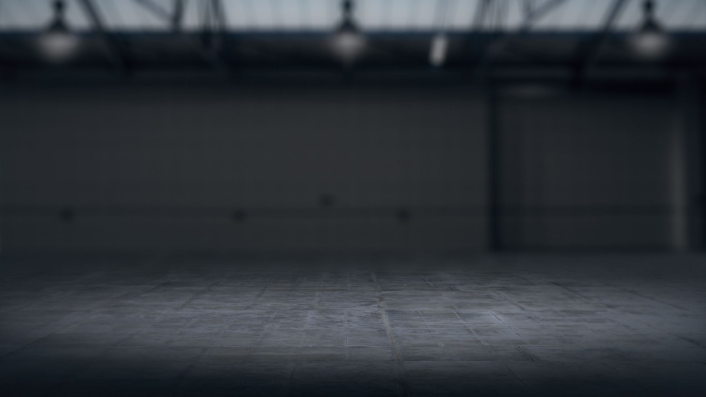
Be “HUMBLE”

Slide 12
H -Humble about our biases and assumptions
U - Understand our own background and culture
M -Motivate ourselves to learn about other cultures
B - Begin to incorporate this knowledge into our everyday work
L - Lifelong commitment to learning
E -Emphasize respect and Empathy

Slide 13
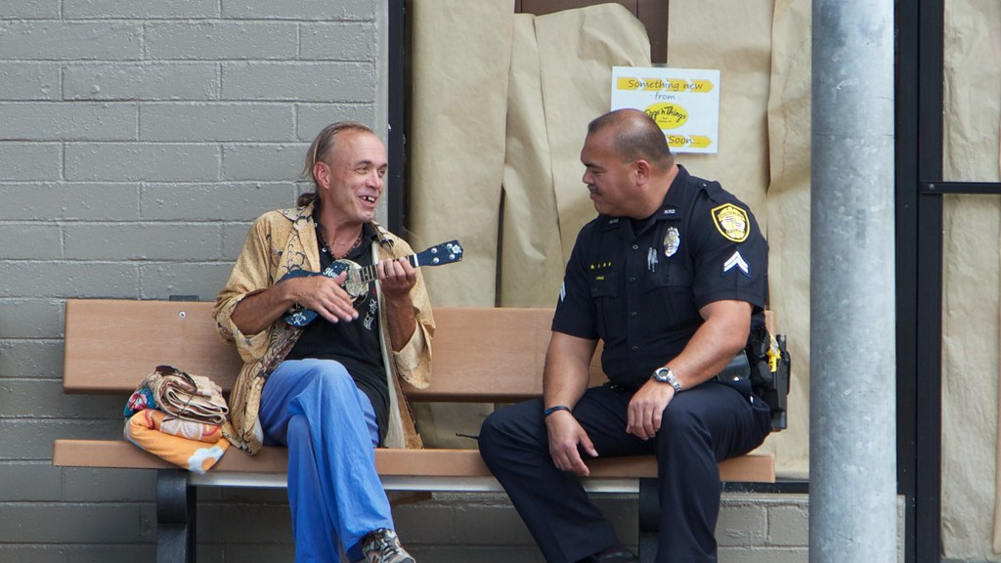
Putting It Into Action
This Photo by Unknown Author is licensed under CC BY-NC

Slide 15
Thank You
James Fitzgerald jfitzgerald@police.Deerfield.ma.us
Kaitlin Richotte-Rock Kaitlin.RichotteRock@csoinc.org

